Slide 1
Effective Heart Disease Prediction Using IBM Auto Ai Service
Presented By,
Poonam Pangarkar

Slide 2
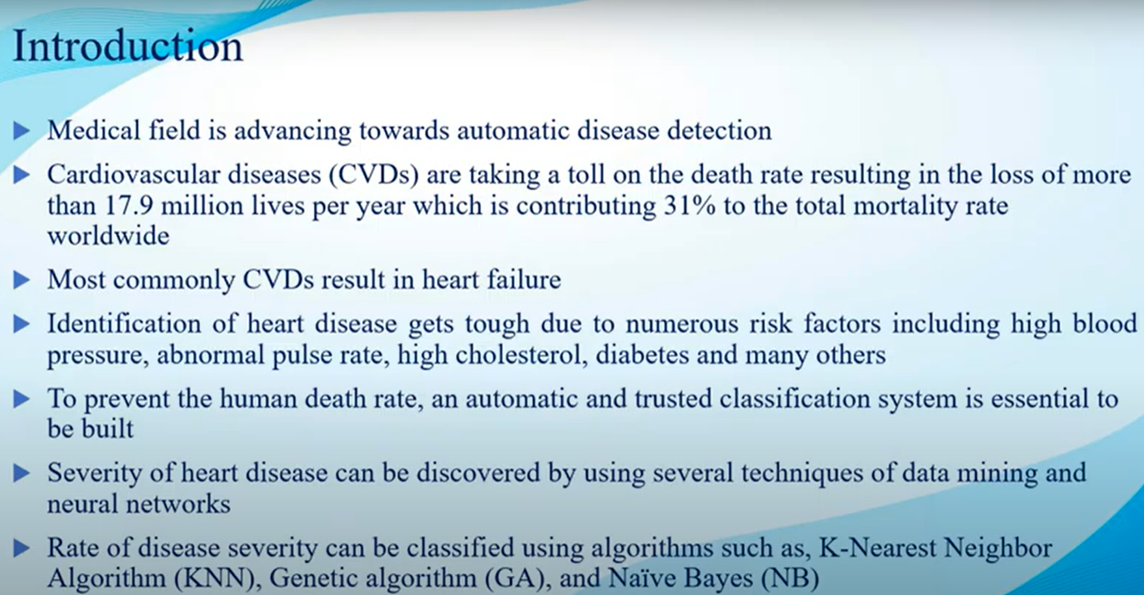

Slide 3
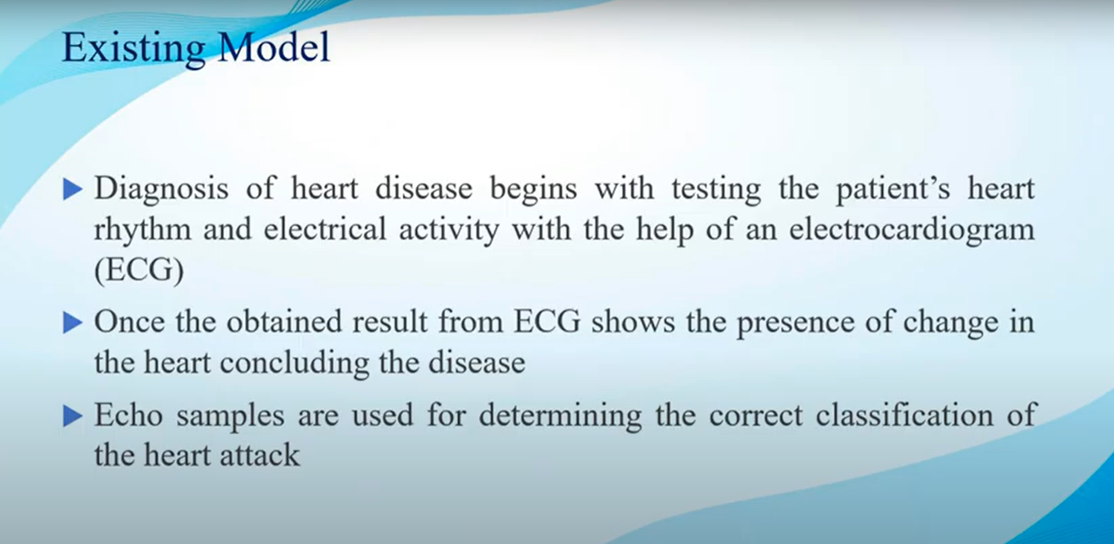

Slide 4
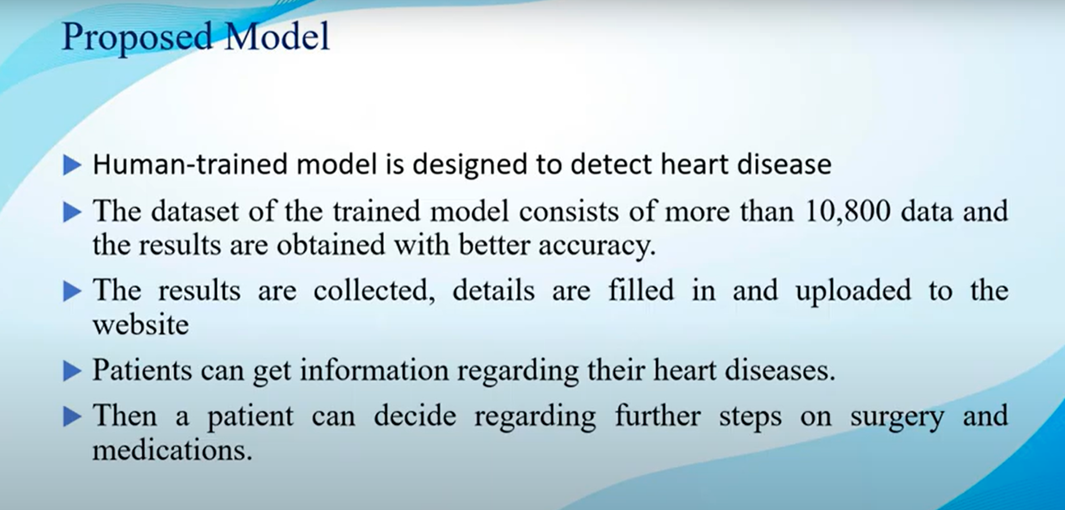

Slide 5


Slide 6
Dataset
AVGHEARTBEATSPERMIN | PALPITATIONSPERDAY | CHOLESTEROL | BMI | HEARTFAILURE | AGE | SEX | FAMILYHISTORY | SMOKERLAST5YRS | EXERCISEMINPERWEEK
93 | 22 | 163 | 25 | N | 49 | F | N | N | 110
108 | 22 | 181 | 24 | N | 32 | F | N | N | 192
86 | 0 | 239 | 20 | N | 60 | F | N | N | 121
80 | 36 | 164 | 31 | Y | 45 | F | Y | N | 141
66 | 36 | 185 | 23 | N | 39 | F | N | N | 63
125 | 27 | 201 | 31 | N | 47 | M | N | N | 13
83 | 27 | 169 | 20 | N | 71 | F | Y | N | 124
107 | 31 | 199 | 32 | N | 55 | F | N | N | 22
92 | 28 | 174 | 22 | N | 44 | F | N | N | 107
84 | 12 | 206 | 25 | N | 50 | M | N | N | 199
60 | 1 | 194 | 28 | N | 71 | M | N | N | 27
134 | 7 | 228 | 34 | Y | 63 | F | Y | N | 92
103 | 0 | 237 | 24 | N | 64 | F | Y | N | 34
101 | 39 | 157 | 20 | N | 49 | M | N | N | 33
92 | 2 | 169 | 26 | N | 36 | M | N | N | 217
80 | 27 | 234 | 27 | N | 50 | M | N | N | 28
82 | 14 | 155 | 30 | N | 70 | F | N | N | 207
63 | 9 | 204 | 26 | N | 42 | M | N | N | 88
83 | 12 | 209 | 29 | N | 38 | M | Y | N | 220
80 | 37 | 157 | 20 | N | 48 | M | N | N | 54
83 | 19 | 223 | 21 | N | 72 | M | N | N | 36
89 | 35 | 197 | 20 | N | 64 | F | N | N | 84

Slide 7
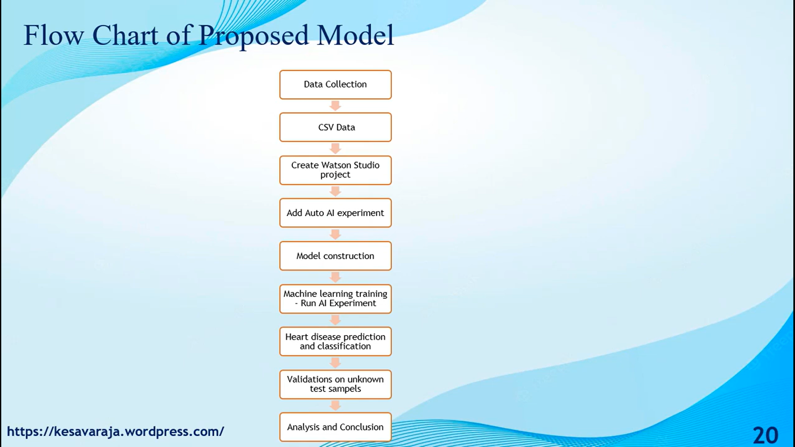

Slide 8
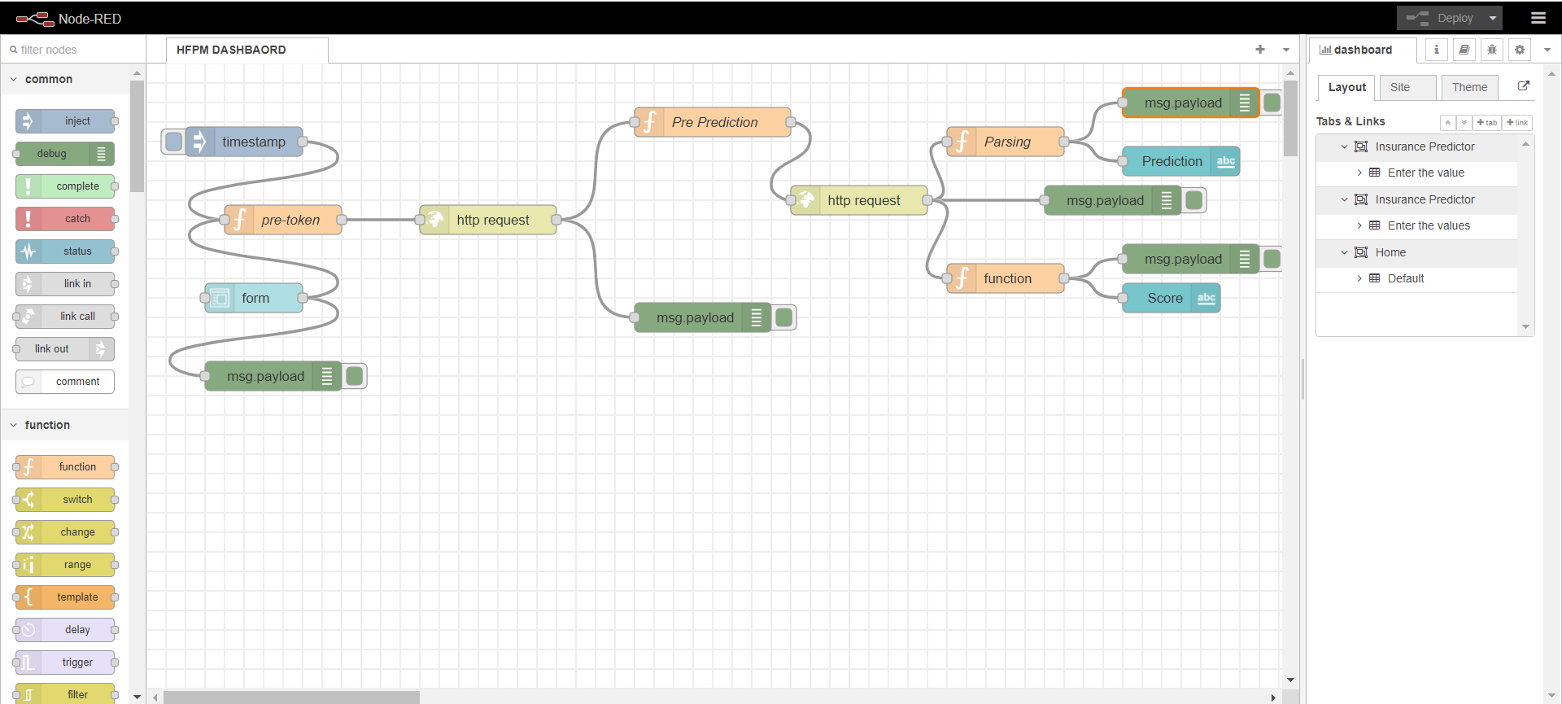
Results:

Slide 9
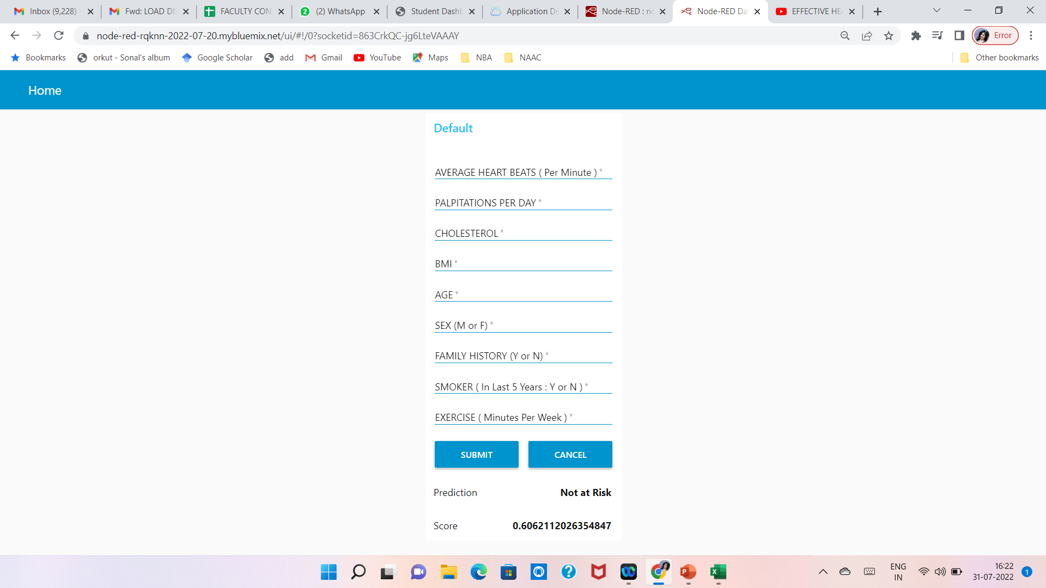
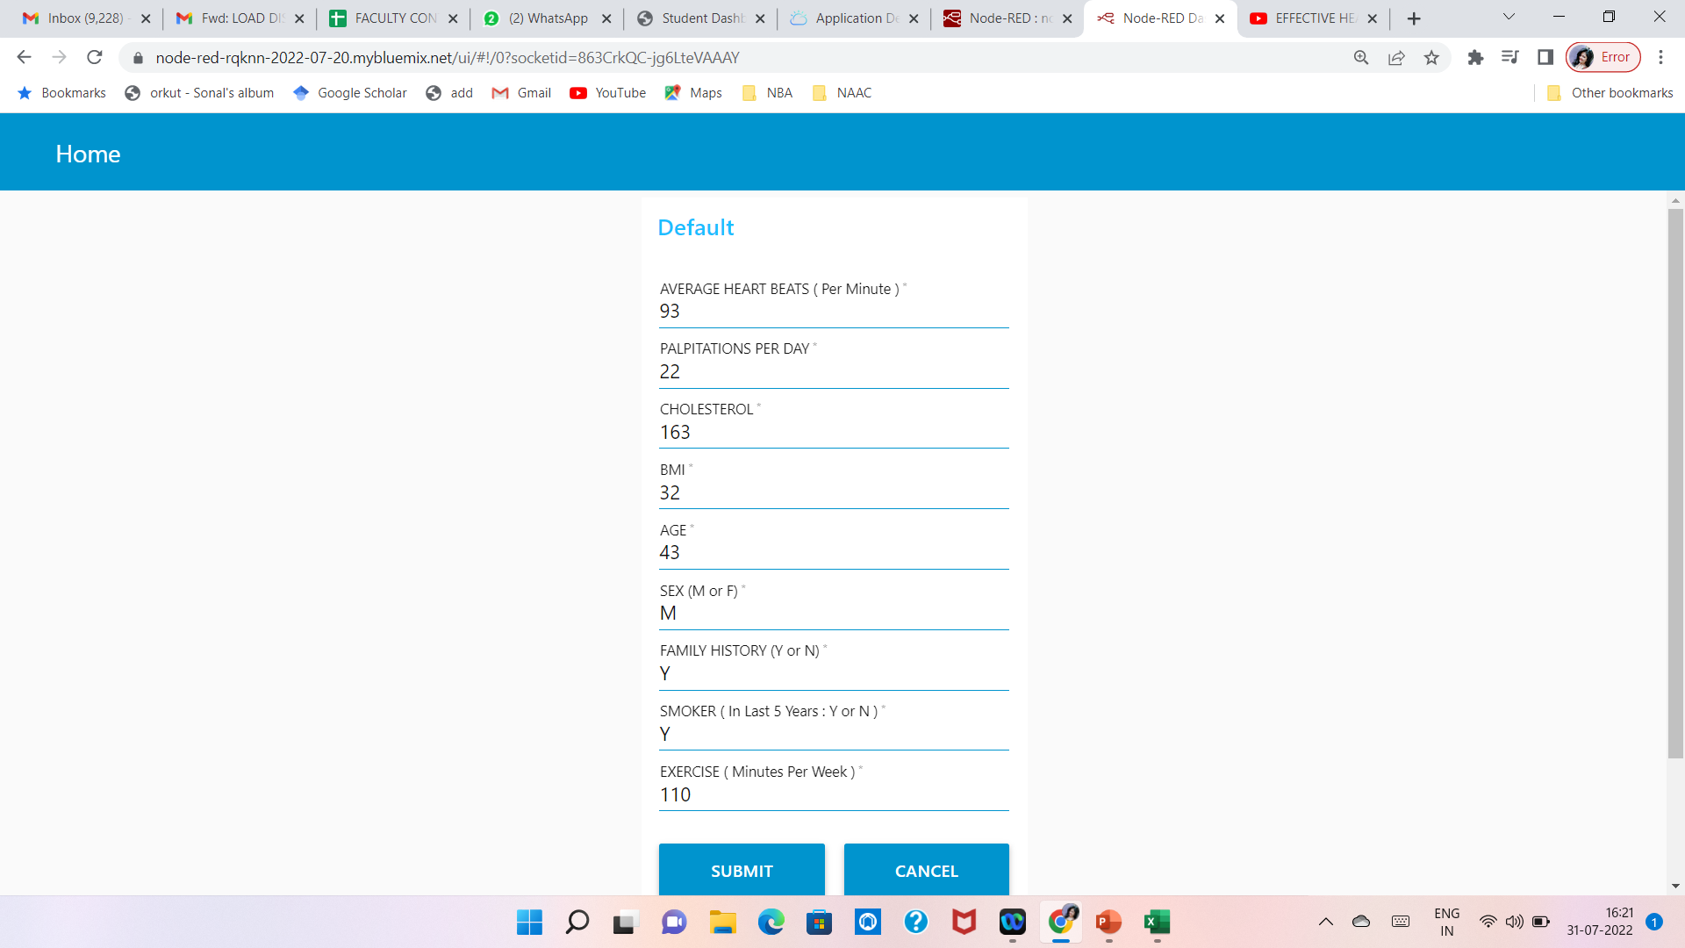
Results:

Slide 10
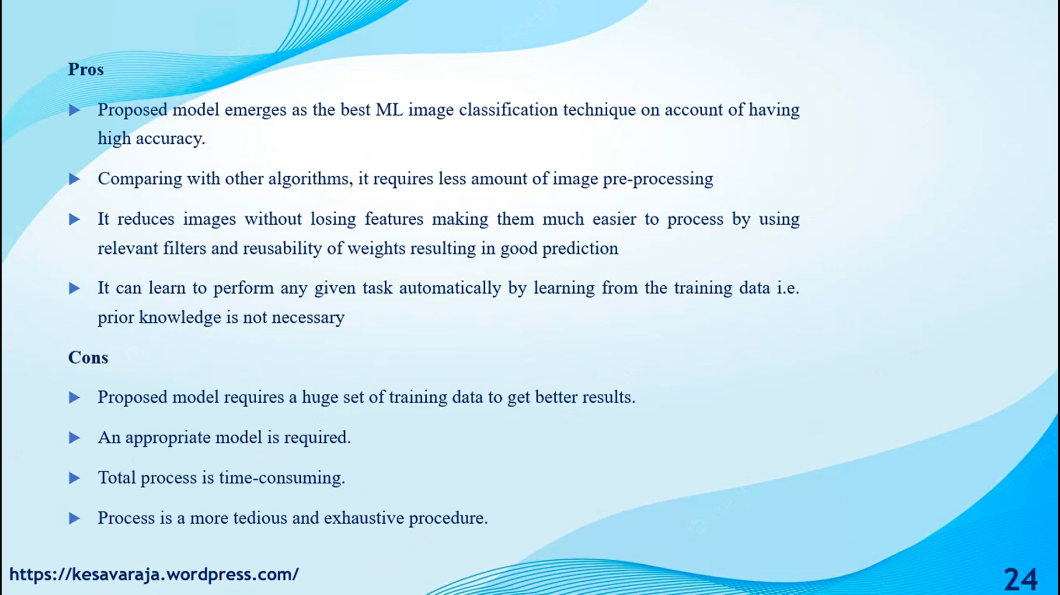

Slide 11
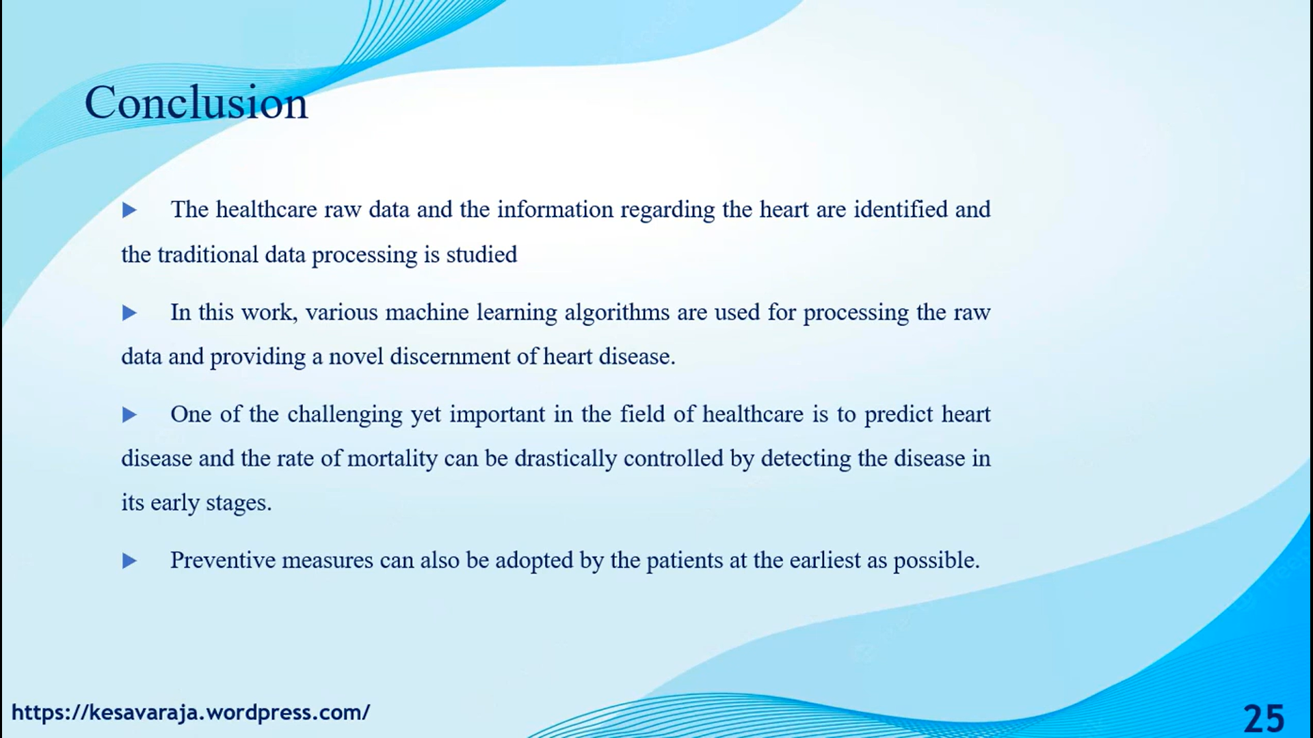

Slide 12
